Slide 1

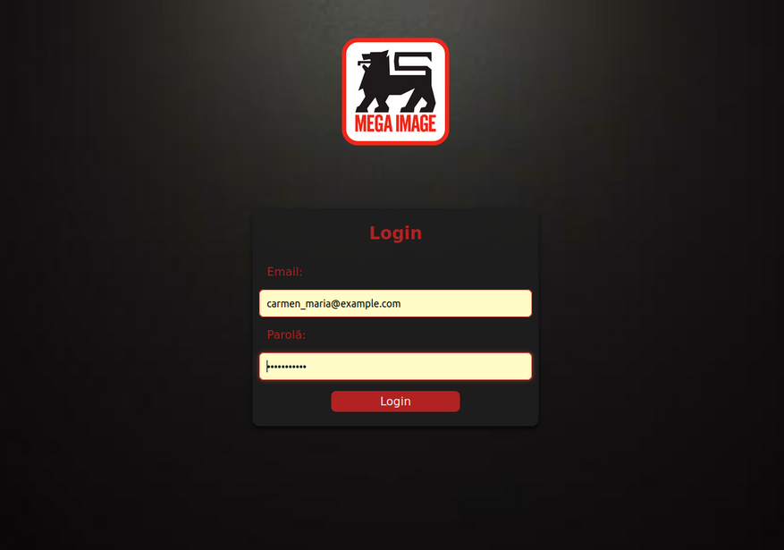

Budget
Planning
By: PowerPuff Girls

Slide 2
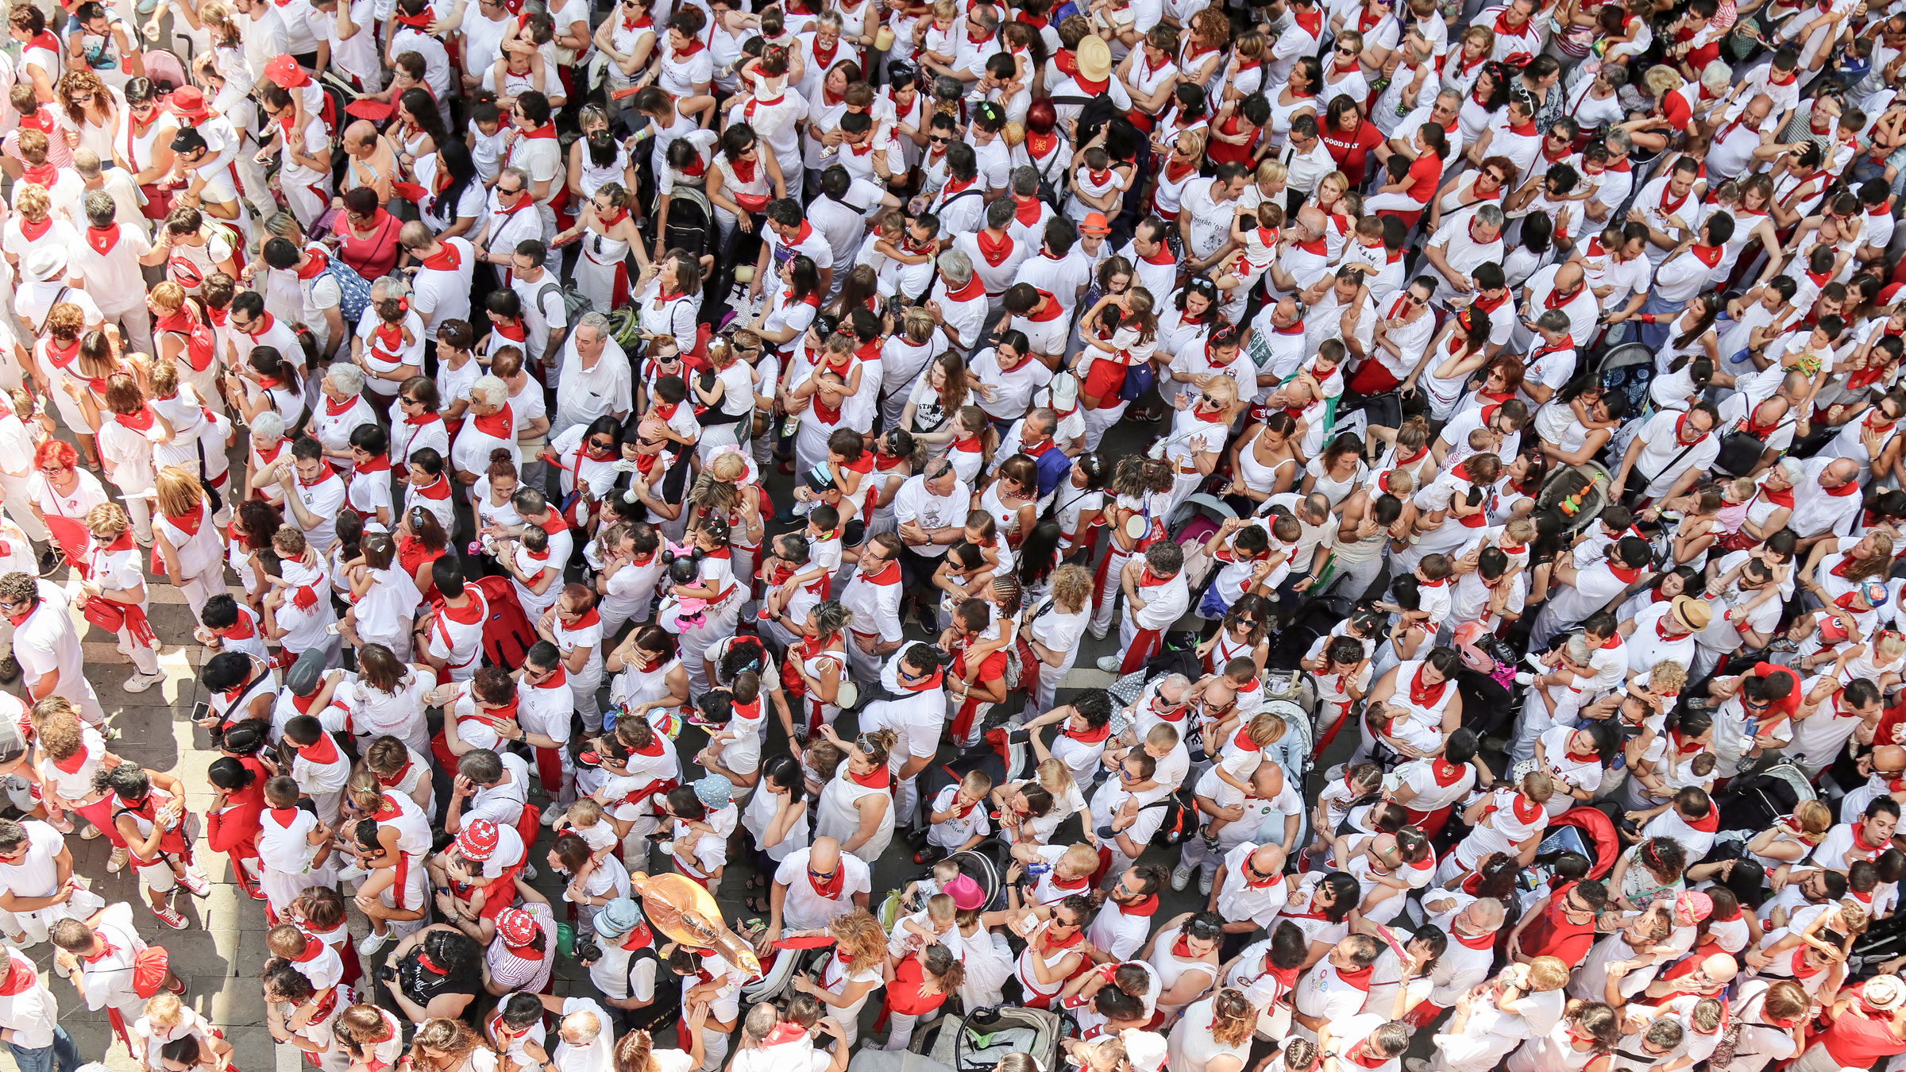
Understanding the User Journey
Key Insights
User-Centric Goals
Design Approach
- Modern consumers struggle with:
- Over-purchasing leading to waste.
- Staying within budget while managing promotions.
- Keeping track of food inventory and expiration dates.
- Efficiency: Automate shopping and inventory processes.
- Personalization: Tailor the experience to individual preferences and needs.
- Sustainability: Encourage responsible purchasing to reduce waste.
- Map the weekly shopping cycle.
- Integrate smart features with user inputs and behaviors.
- Leverage existing technologies like the Connect card for seamless data transfer.

Slide 3

Smart Inventory Management:
- Why? Consumers often forget what they have or what’s expiring.
- How? Weekly fridge checklists prompt users to track their inventory.
01
Recipe-Driven Shopping:
- Why? Prevents waste by utilizing soon-to-expire ingredients.
- How? Suggests recipes dynamically based on available ingredients and their expiration.
02
Core Features and Their Rationale
Budget Setting and Tracking:
- Why? Budgeting is a critical concern for most households.
- How? Users set a spending cap, and the system ensures recommendations align.
03
Personalized Promotions:
- Why? Promotions are often irrelevant to the user.
- How? Syncs with user history and preferences to highlight meaningful deals.
04

Slide 4
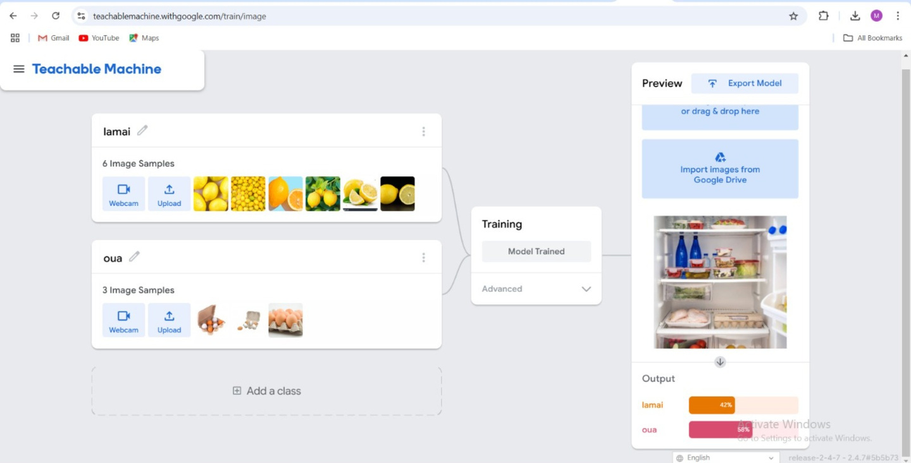
Technology-Driven Implementation
Data Integration with Connect Card:
- Enables real-time import of purchases.
- Provides insights into shopping patterns for tailored suggestions.
Machine Learning for Recommendations:
- Analyzes user preferences, previous purchases, and current inventory.
- Suggests recipes, ingredients, and promotions.
Real-Time Updates:
- Dynamically adjusts the shopping list based on user actions (e.g., early purchases).
Notification System:
- Sends reminders for fridge checks, expiring items, and weekly suggestions.
Tools Used:
- Frontend: Responsive HTML and CSS for user interfaces.
- Backend: JavaScript and JSON for data handling and logic.
- Data Storage: JSON files for storing recipes, products, and promotions.

Slide 5
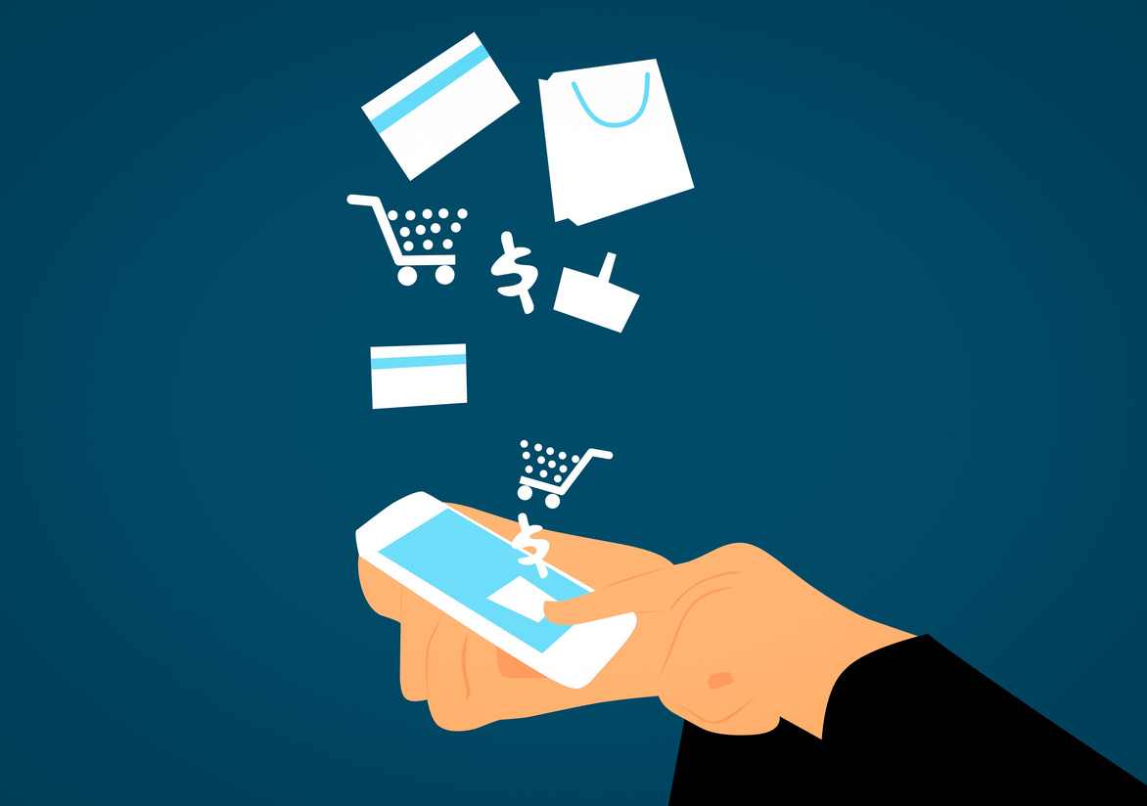
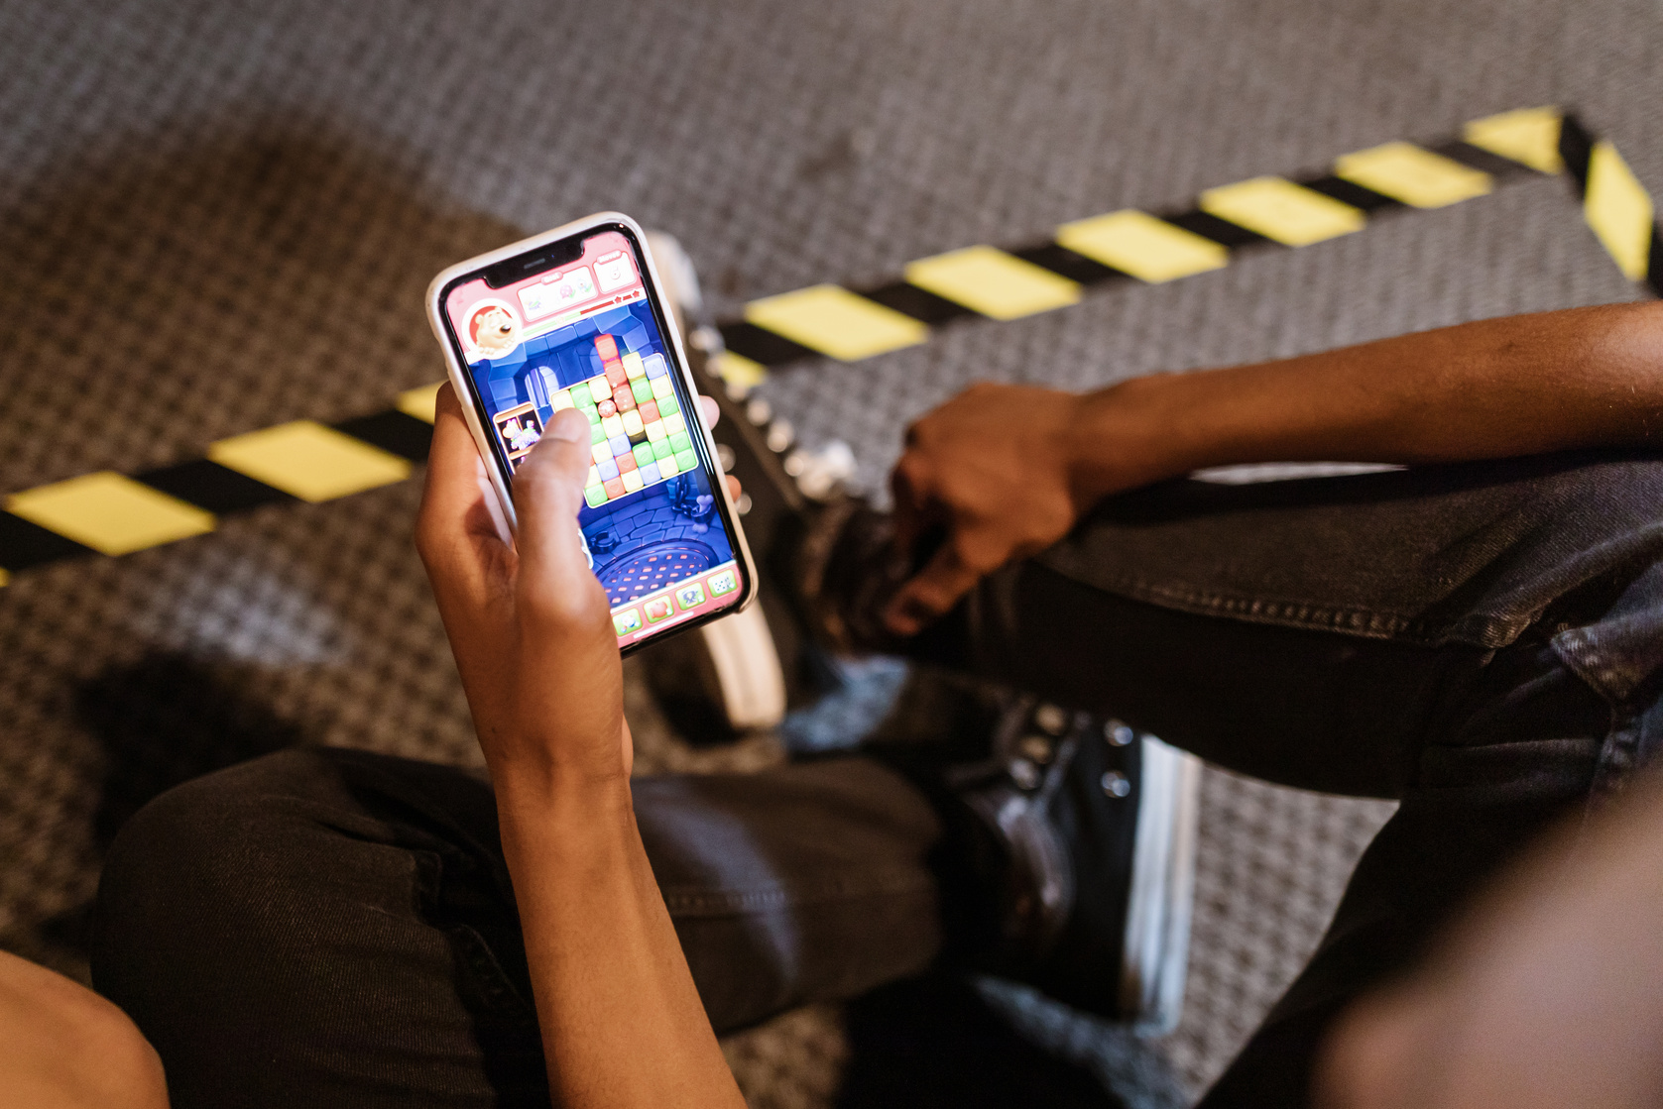

Behavioral Insights and Motivational Design
Target Behaviors
Incentives and Rewards
Psychological Levers
- Reduce impulsive buying.
- Increase awareness of inventory.
- Encourage sustainable consumption.
- Gamify targets like staying within budget or reducing waste.
- Offer rewards for goal achievement (e.g., discounts, points).
- Convenience: Reduce cognitive load with automated lists and suggestions.
- Personalization: Make users feel understood and valued.
- Sustainability: Appeal to eco-conscious mindsets.

Slide 6

Measuring Success
Key Metrics:
- Reduction in food waste (measured via user reports).
- Percentage of users staying within their set budgets.
- Engagement rates with personalized promotions.
- Number of recipes successfully generated and used.
Feedback Loop:
- Regular surveys to refine the system.
- Analyze user behavior for continuous improvement.

